Slide 1
Programming The Hardware

Slide 2
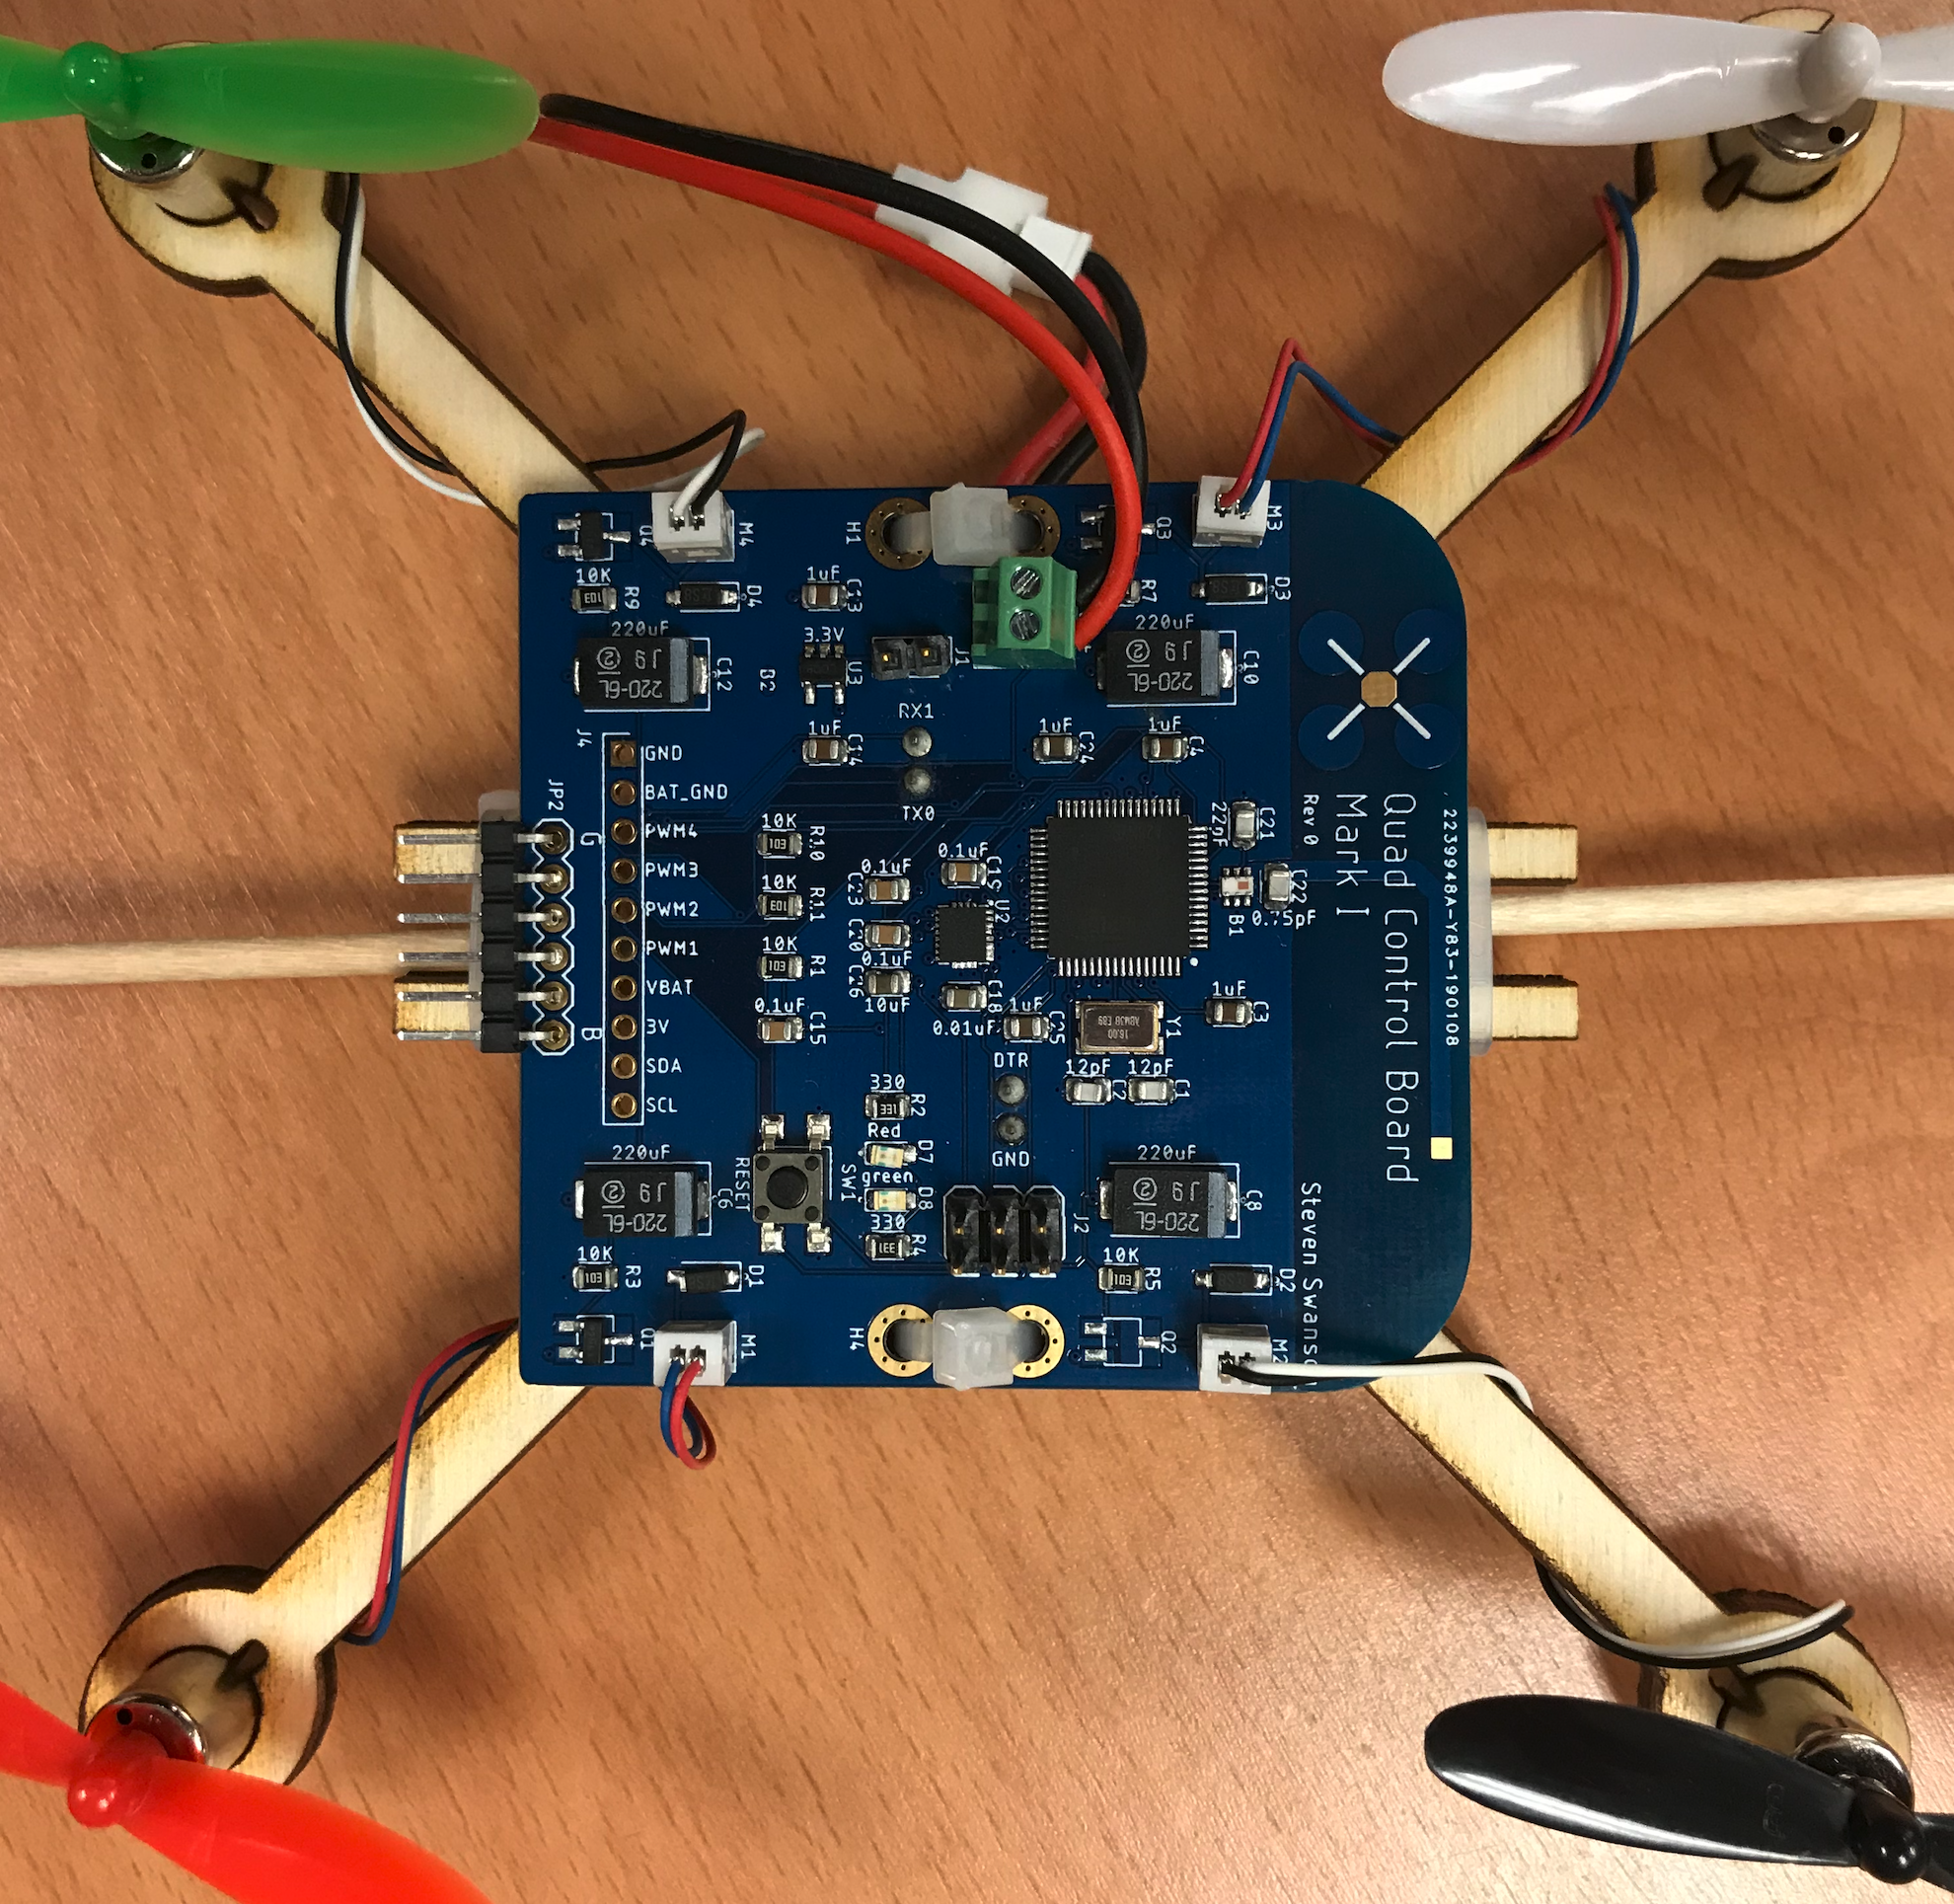
The Flight Control Board

Slide 3
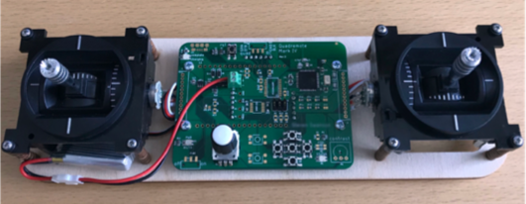
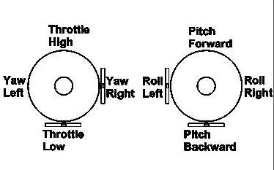
Controller
Read user input for flight
2 ”gimbals”
Left: throttle and yaw
Right: pitch and roll
Yaw, pitch, and roll are spring-loaded to return to neutral
Throttle stays where you put it.
Buttons and a knob for tuning
A radio for communication
A battery charger

Slide 4
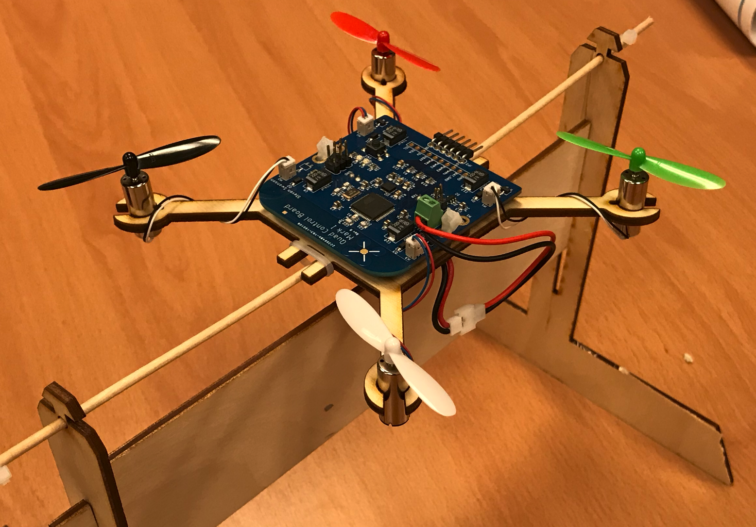
The Test Stand

Slide 5
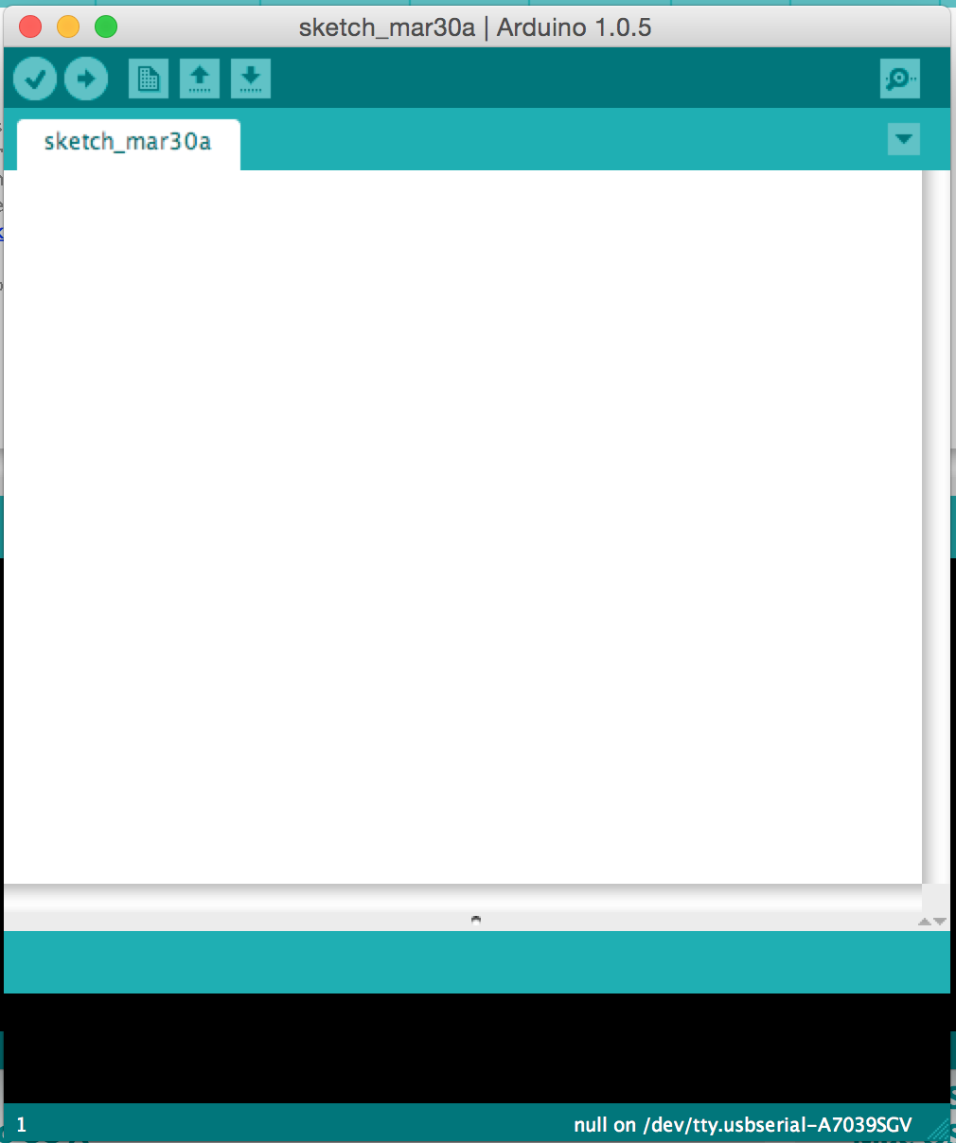
The Arduino IDE
User-friendly IDE for Arduino programming
Programming the microcontroller is easy
Installation is easy

Slide 6
Software Plan
This Lab
Meet the hardware
Learn to use it
Sensing Lab -- IMU Filtering
PID Lab -- Implement control
Do everything on the Test Stand first, then move to your quadcopter

Slide 7
Quadcopter Firmware
Sensing
Use the IMU to measure the orientation of the quadcopter
Filter IMU readings to eliminate noise
Control
Based on IMU measurements, maintain stability
Receive commands from remote
Implement them

Slide 8
Remote Firmware
Control
Measure gimbal position
Transmit readings to the quadcopter
Tuning
Your control algorithm will have many parameters
You’ll need to tune them in real time

Slide 9
Lab Tasks
Use everything
Install IMU library. Read values from IMU.
Read the values from the gimbals.
Drive a motor.
Read values from the knob and buttons.
Build a remote-controlled motor
FCB drives motors.
Remote control reads gimbals and transmits value to run motor at.
This is the basic framework for your quadcopter and remote firmware.

Slide 10
Brushed DC Motors

Slide 11
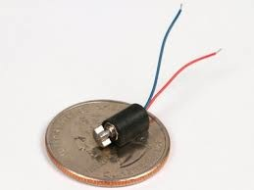
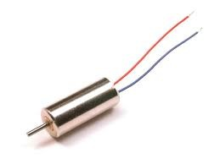
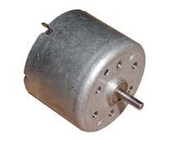
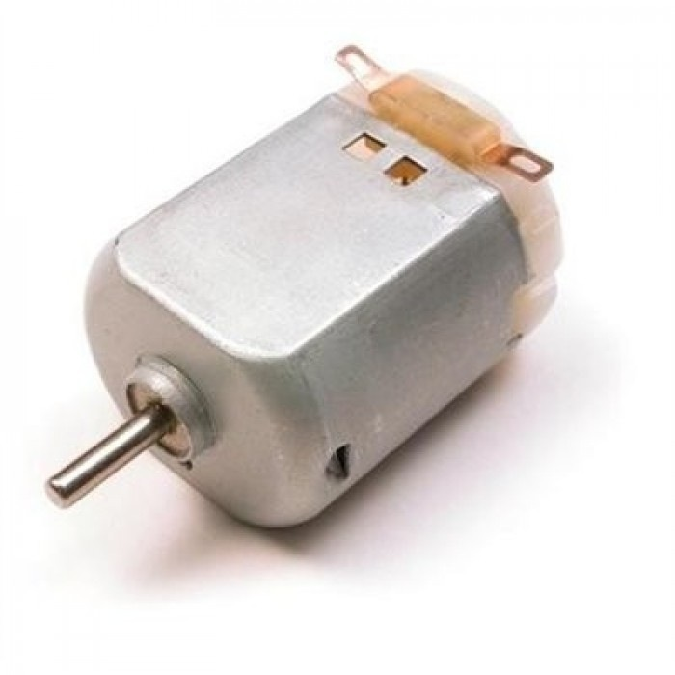
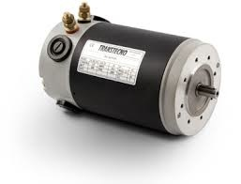
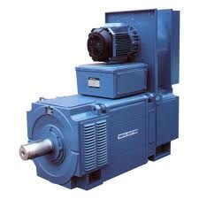
Brushed Motors

Slide 12
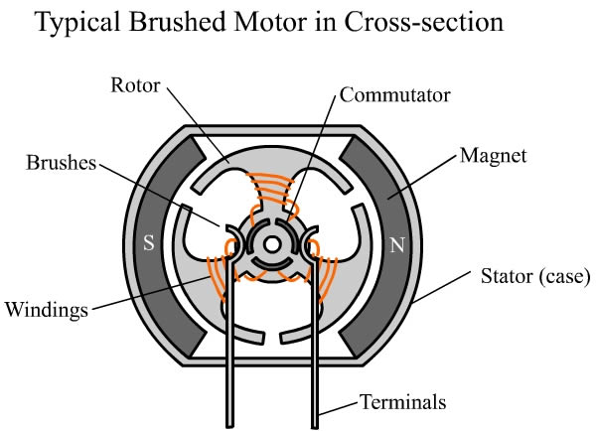
Construction

Slide 13
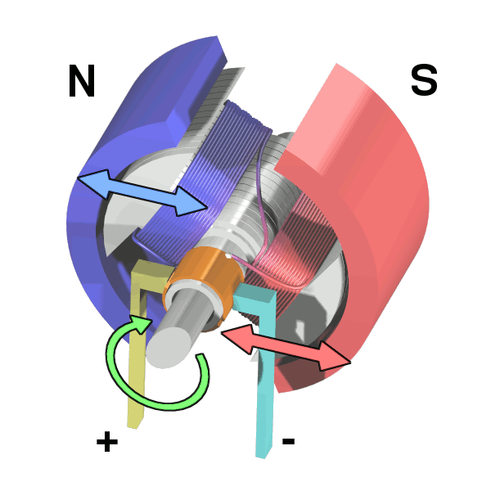
Operation

Slide 14
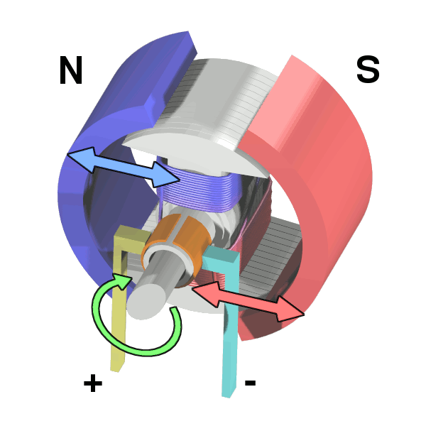
Operation

Slide 15
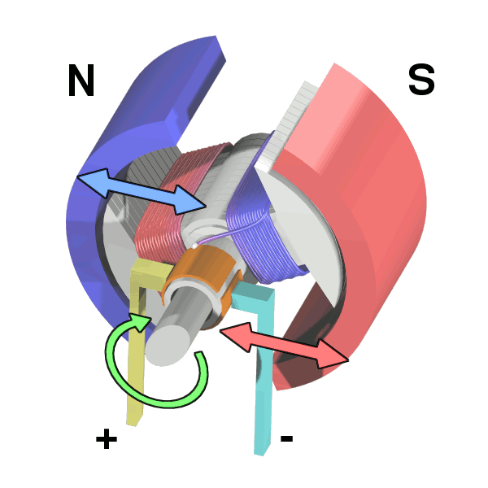
Operation

Slide 16
Operation

Slide 17
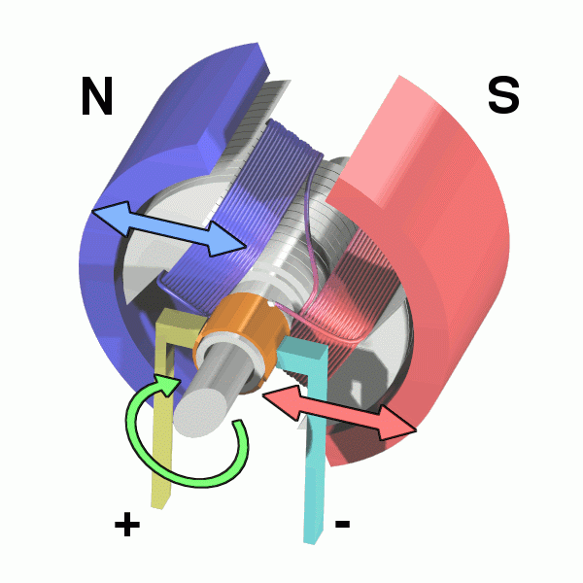
Operation

Slide 18
Controling Brushed Motors
Speed ∝ Voltage ∝ Current
Vary the input voltage
Generating varying voltages is non-trivial
You need an digital-to-analog converter
Really, we just need the average voltage to vary

Slide 19
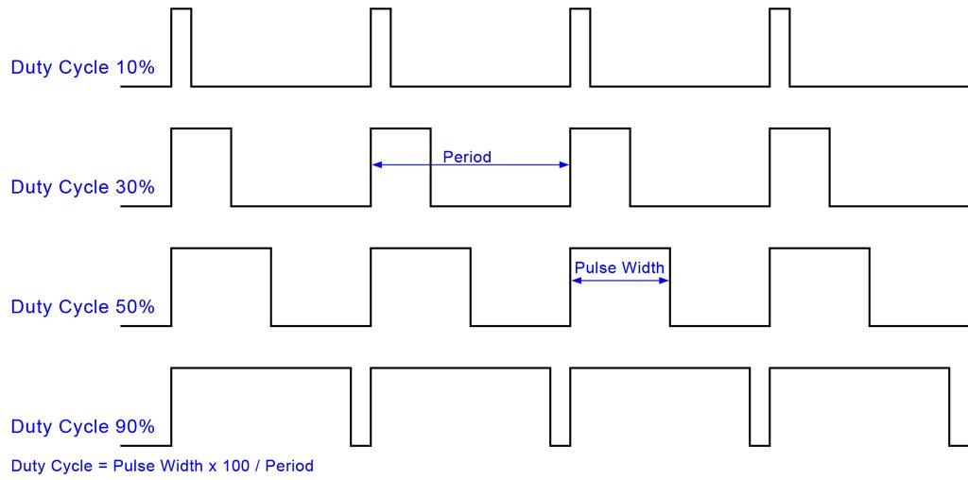
Pulse-width Modulation (PWM)

Slide 20
PWM in Arduino
The red board board has several analog output (PWM) pins
analogWrite (int pin, int v)
‘v’ is the duty cycle (0…255)
‘pin’ is the the pin

Slide 21
Gimbals

Slide 22
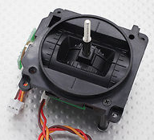
The Gimbals
Each stick is a “gimbal”
a mechanism, typically consisting of rings pivoted at right angles

Slide 23
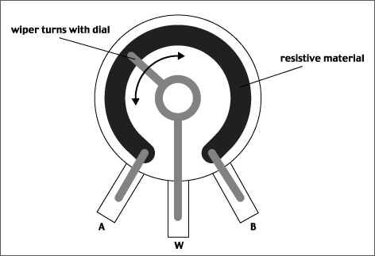
Anatomy of a Gimbal
Two potentiometers measure X and Y movement of the stick.
Potentiometer – A variable voltage divider
As the slider’s movement changes the resistance from A and W and W and B.
The voltage at W is proportional to the position of the gimbal.
In reality, the resistances are always > 0, so W never reaches VCC or GND.
Our gimbal
Frsky PR10
Total resistance: 2.4KOhms
Rated voltage: 5V

Slide 24
Reading the Gimbals
The red board board has several analog input pins
analogRead(int pin)
Takes a voltage between GND and Vcc and maps it to 0—1024
The Remote library defines constants for which pins to read.

Slide 25
Status LEDs
The remote has 2 status LEDs
They are useful for letting you know when the quad is armed, etc.
Use digital_write() to control them.
See Remote.h for pins

Slide 26
Buttons

Slide 27
Rotary Encoder

Slide 28
Radio

Slide 29
Remote Software Path
Scale and bound gimbal readings
P, Y, R: -512-512
T: 0-1023 for T
Tuning parameters
Set tuning parameters with the UI
Send them to the quadcopter
Transmit updates at 10-20Hz.
No faster – share the spectrum!

Slide 30
Quadcopter Datapath
Read the throttle
Control the motors

Slide 31
The End

Slide 32
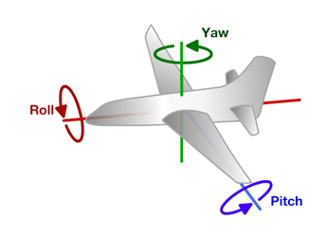
Principles of Operation (1)
An even number of motors provides lift and control in 6 dimensions
Spatial dimensions: x, y, z
Pitch: rotation around left-right (y) axis
Roll: rotation around the front-back (x) axis
Yaw: rotation around the top-bottom (z) axis
A flight computer operates a closed-loop controller to maintain stability and implement pilot commands.
Z
X
Y

Slide 33
Controlling Pitch
Pitch forward
More thrust to the rear
Less to the front
Pitch backward
Less thrust to the rear
More to the back

Slide 34
Controlling Roll
Pitch Left
More thrust to the right motor
Less to the left
Pitch Right
More thrust to the left motor
Less to the Right

Slide 35
Controlling Yaw
Rotate CCW
More thrust to the CCW motors
Less to the CW
Rotate CW
More thrust CW motors
Less to the CCW

Slide 36
Some Possible Configurations
Hexa +
Hexa x
“Plus”
“X”
Octa +
Octa x
“Octothorpe”
Y 6

Slide 37
Maintaining Stability
Multi-rotor aircraft are inherently unstable
Mismatched motor power (voltage variation, manufacturing variation in motors or props)
Variation in air currents and density.
Once perturbed, there’s no force acting on the aircraft to return it to equilibrium.

Slide 38
Maintaining Stability
Multi-rotor aircraft require a closed loop controller
Sensors detect aircraft movement and orientation
Controller adjusts the power to motors to maintain desired location and orientation
Multi-rotor aircraft use a few sensors to maintain stability
Accelerometers (absolute pitch and roll)
Gyroscopes (changes in pitch, roll, and yaw)
The flight computer implements the control algorithm
Usually a proportional, integral, derivative (PID) controller implemented in software.
We will talk more about this later.
With PID controllers for pitch, yaw, and roll multirotor aircraft can achieve stable flight.

Slide 39
Higher-order Navigation
Large multi-rotor aircraft can do more
Maintain geographic position
Maintain altitude
Follow an prescribed/pre-programmed path
More sensors required
Magnetometers (absolute yaw or heading)
GPS (absolute location and altitude)
Barometers (altitude)

Slide 40
Lab 3: Make all Your Hardware Work a.k.a Remote Controlled Motors

Slide 41
Demos
Show PWM signal changing duty cycle
Show flyback
Effect of diode
Show effect on power supply noise
Show filter on pwm line
Effect of resistor and capacitor on PWM
Show output of FET
Show affect of filter on power supply noise

Slide 42
The Inputs and Outputs
Gimbals – How they work and how to read them.
Brushed Motors – How they work and how to drive them.
The IMU – microcontroller and IMU communicate.
The serial display, LEDs, etc. – Communicating with the pilot.

Slide 43
Flyback
Opening S1 makes M1 an inductor
Drives up voltage M1-
Can destroy the switch
Can cause current to back to power supply.
Causes noise on power supply.
This is called “fly back”
Adding a diode relieves the problem.

Slide 44
Motor Driver
Pulse-width modulation (PWM)-controlled MOSFET
The microcontroller will drive the MOSFET
The MOSFET will drive current to the motor.

Slide 45
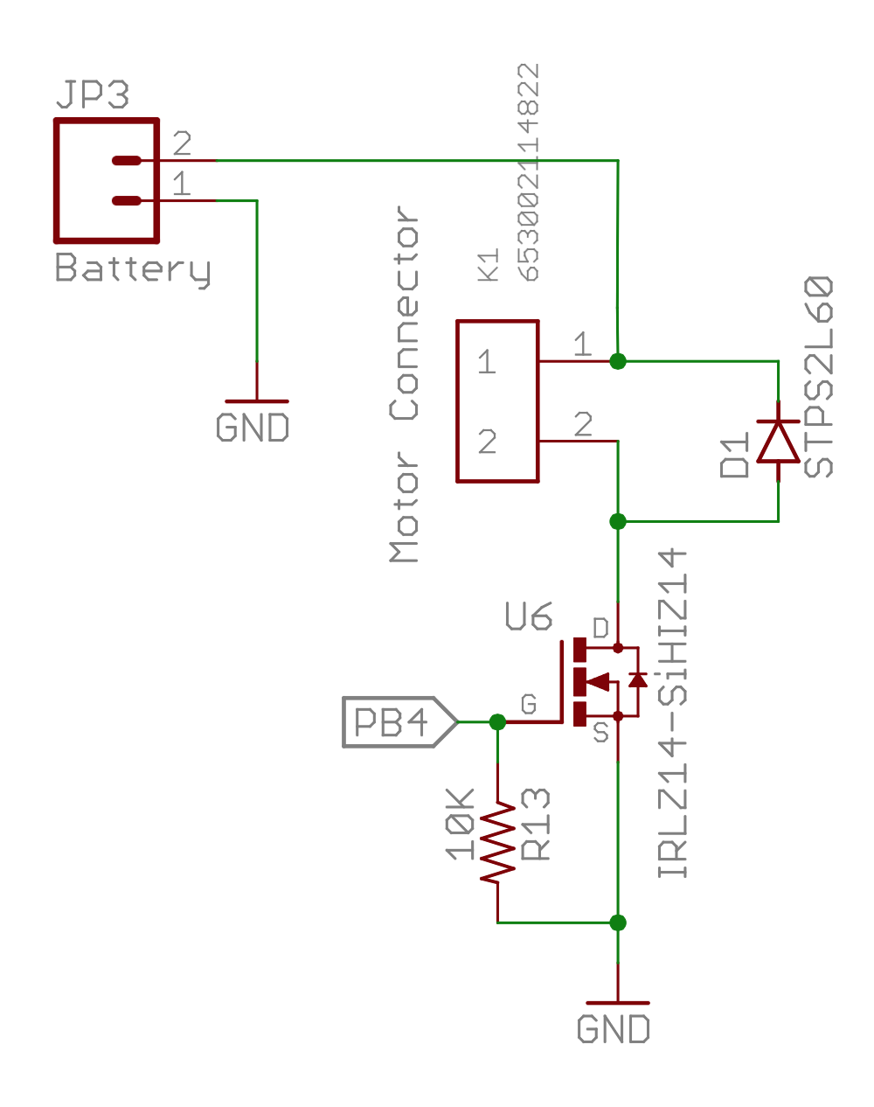
Our Motor Circuits

Slide 46
The Serial LCD Display

Slide 47
Display Text on the Remote
The LCD display on the remote is connected to the second serial port on the redboard
The LCD_library provides a nice interface for writing to it
Docs here: http://playground.arduino.cc/Code/SerLCD

